Slide 1
Unit 7-4
Areas of Trapezoids, Rhombi, and Kites
PLANE Geometry

Slide 2

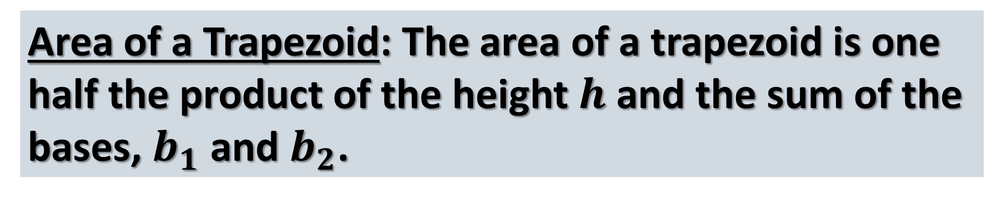
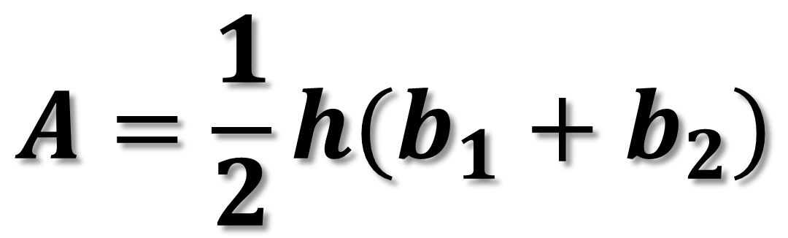


Area of a Trapezoid: The area of a trapezoid is one half the product of the height $h$ and the sum of the bases, $b_{1}$ and $b_{2}$.
$$b_{1}$$
$$A=\frac{1}{2}h(b_{1}+b_{2})$$
$$h$$
$$b_{2}$$

Slide 3


Example 1: Find the Area.
5
$$8$$
$$12$$

Slide 4


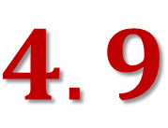
Example 2: Find the Area.
3.3
$$3.7$$
$$4.9$$
$$8.1$$

Slide 5


Example 3: Find the Area.
11
$$45°$$
$$16$$

Slide 6


Example 4: Find the Area.
5
$$60°$$
$$7$$

Slide 7


Example 5: Find the Area.
6
$$45°$$
$$11$$

Slide 8




$$A=80$$
Example 6: Find the $x$.
8
$$x$$
$$12$$

Slide 9


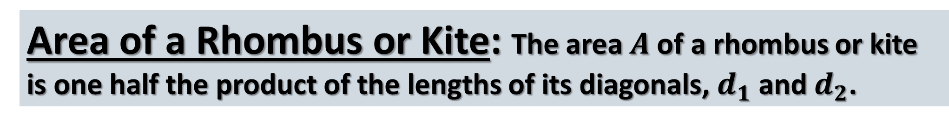

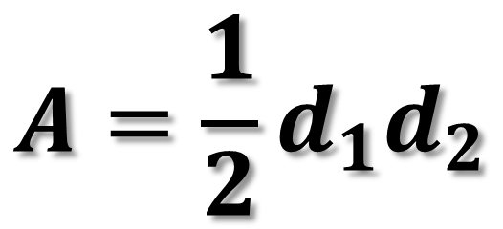

Area of a Rhombus or Kite: The area $A$ of a rhombus or kite is one half the product of the lengths of its diagonals, $d_{1}$ and $d_{2}$.
$$A=\frac{1}{2}d_{1}d_{2}$$
$$d_{1}$$
$$d_{1}$$
$$d_{2}$$
$$d_{2}$$

Slide 10


Example 7: Find the Area.
$$8$$
$$3$$

Slide 11


Example 8: Find the Area.
$$5$$
$$7$$

Slide 12


Example 9: Find the Area.
$$8$$
$$15$$

Slide 13



$$A=75$$
Example 10: Find the $x$.
$$x$$
$$15$$

